Slide 1

Toronto’s Venues by Neighbourhood
IBM Data Science
Final Capstone

Slide 2

Introduction
To open a new business it's very important to analyze the location. On of the important factors to consider is the amount of similar businesses in the prospect areas. This report will classify venues into categories and analyze the amount of venues per neighbourhood.

Slide 3
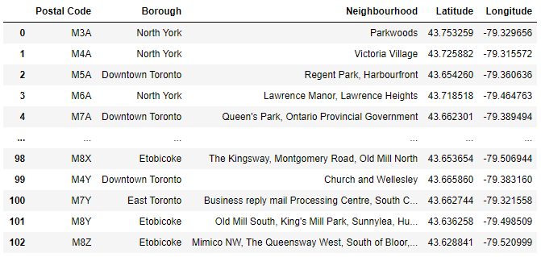
Data
Data used for this report is composed of geographic data of Toronto and venue's data from Foursquare

Slide 4
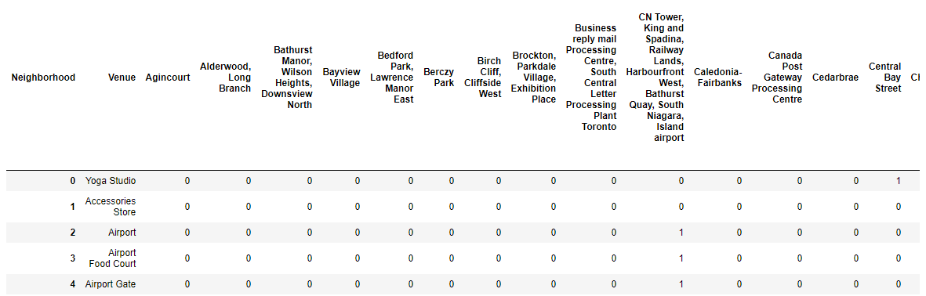
Methodology
Using Foursquare’s API information about the following information about the venues is obtained
It is then encoded into dummies, transposed and grouped by sum to obtain the amount of different venues by neighbourhood

Slide 5
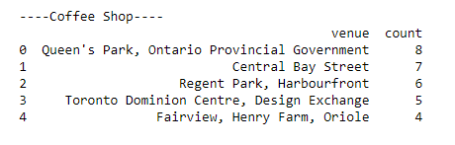
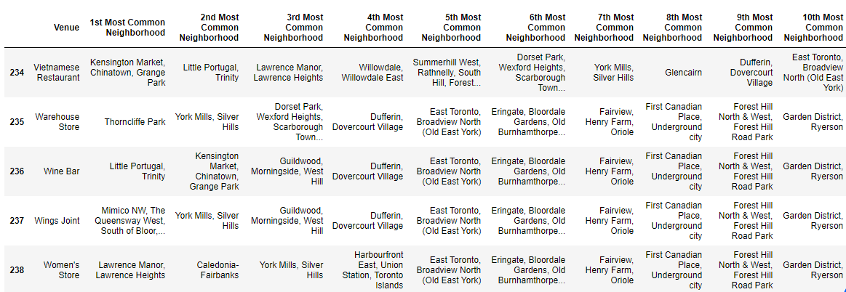
Results
Once the data is analyzed, for each type of venue the most popular neighbourhoods are returned

Slide 6
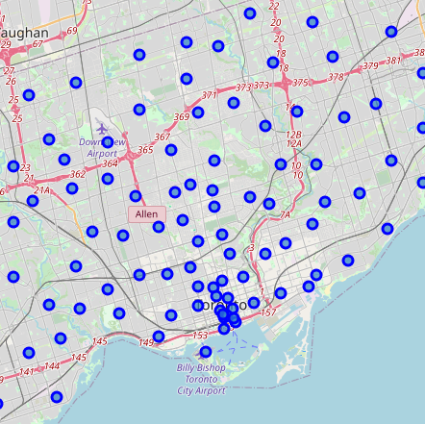
Discussion
With the above information it's easy to check the amount of venues per neighbourhood. One just needs to find the type of venue he is interested in and you can see the neighbourhoods were those types of venues are popular. It could be a good strategy to locate a business in an area which is already considered an area where those type of venues are popular or good, but it could also be a good strategy to open the business in a neighbourhood where there aren't yet any venues like that.

Slide 7

Conclusion
From the results section we can see that the amount of venues per neighbourhood is pretty small. In order to get more reliable insights more information on the venues would be needed, and it would help a lot if the ratings of these venues were included.

